Slide 1


Software Product Line Engineering
Rachel Appel
JetBrains
http://rachelappel.com
rachel.appel@jetbrains.com

Slide 2
What is a Software Product Line?
A software product family is a group of software products built from common assets.
They share a managed set of features satisfying the specific needs of a particular market segment or mission.
Notes:
While traditional software development focuses on the individual system, product line engineering must always address the market as a whole
As a consequence, development decisions for the individual product are always linked to the product line at large. This relationship must be managed from an economic point of view.
Reuse as business strategy rather than a granular programming technique

Slide 3

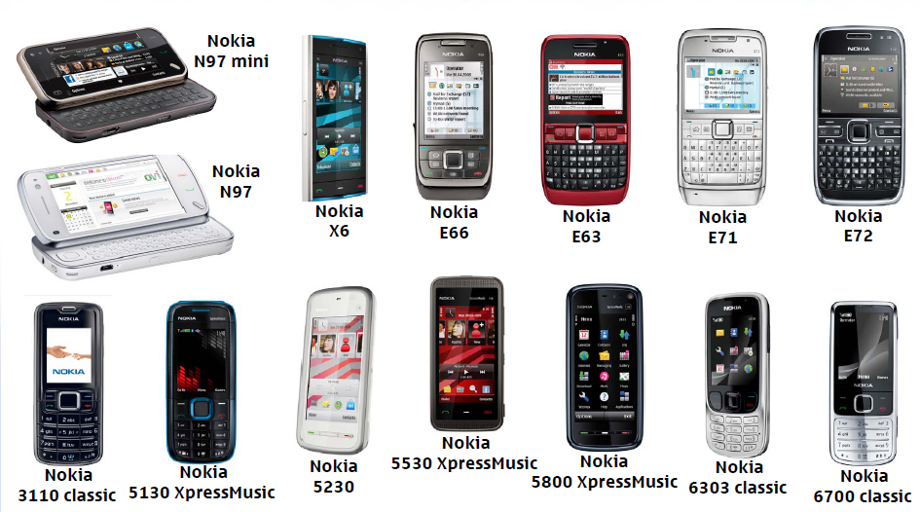



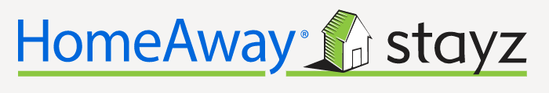

Financial Systems
E-Commerce Systems
Insurance Systems

Slide 4
Software that is not a product line
APIs
Reusable libraries or components
Clone-and-own systems
Customizable software
A suite or licensing bundle [e.g., Adobe Suite, MS Dynamics]

Slide 5
Why product line engineering?
Reduction to less than 50% time to market
Reduction of code size by more than 70%
Significantly reduced cost of quality assurance
Product defect density reduced to 50% of original rate
Reduction of calibration and maintenance efforts
Reduction of resource consumption
Common look-and-feel

Slide 6
Downsides
More up-front costs, time, effort
If migrating, significant time away from product building
The need for specialized personnel may arise as product scales
Developers tend to think of reuse at the component level

Slide 7
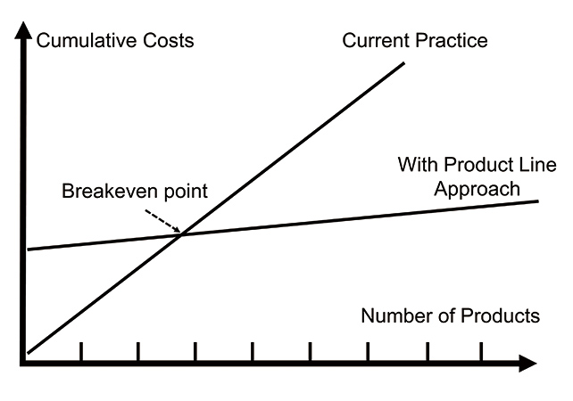

Slide 8



Clone-and-own systems
Product 1
Product 2
Product 3
Product 4
Product 5
Product 6

Slide 9
Product line
Core/Base (Platform)
Core/Base (Platform)
Core/Base (Platform)
Core/Base (Platform)

Slide 10
Compare Single Systems to Product Lines
Single System
Product Line
Focus on one product
Reuse at component level as a development strategy
Leverages an asset base/platform
Variations per product
Reuse as a business strategy at the product level

Slide 11
Example: Online Market
Marketplace
Marketplace
Marketplace
Storefront
Storefront
Storefront
Shopping Cart
Shopping Cart
Shopping Cart
Wish List
Wish List
Recurring Purchase List
POS [Credit Card]
POS [PO]
POS [both]

Slide 12

Formal and Pedantic Methodologies in Academia
PuLSE
SEI project
BAPO model

Slide 13
Design your product line
Determine if your product requires a product family
Is there a market need for a product line?
Is there a significant amount of reusable base with customizations?
Design the commonalities
Regular commonalities during requirements planning with focus on a platform
Design the variabilities
Use variability modeling

Slide 14
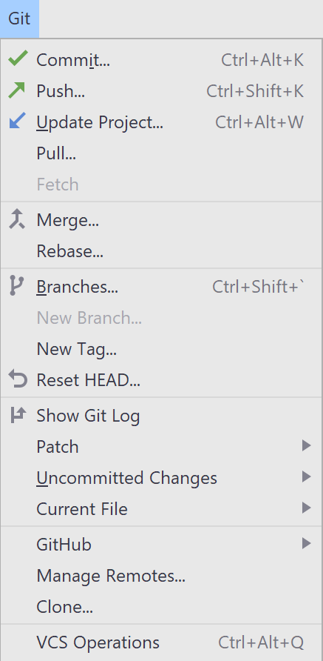
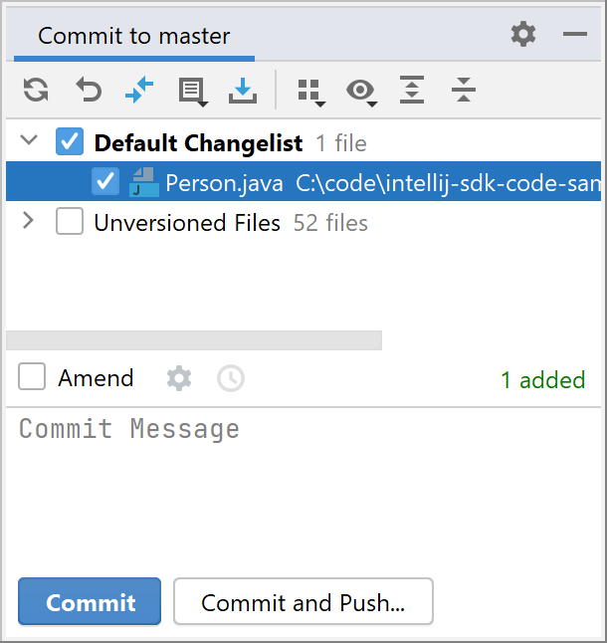
Commonalities
Same across all products
Same look and feel
Same functionality

Slide 15
Variability
Variability modeling integrates with popular design methodologies
UML, DDD, OOP design, etc…

Slide 16
Variability Modeling terms & concepts
A variability subject is a variable item of the real world or a variable property of such an item
A variability object is a particular instance of a variability subject
A variation point is a location in a model where a subject varies
A variant is a representation of a variability object within domain artefacts

Slide 17
Steps to variability modeling
Identify the thing that varies, i.e., the subject
Define the variation point within the context of the product line
Define the variant itself

Slide 18
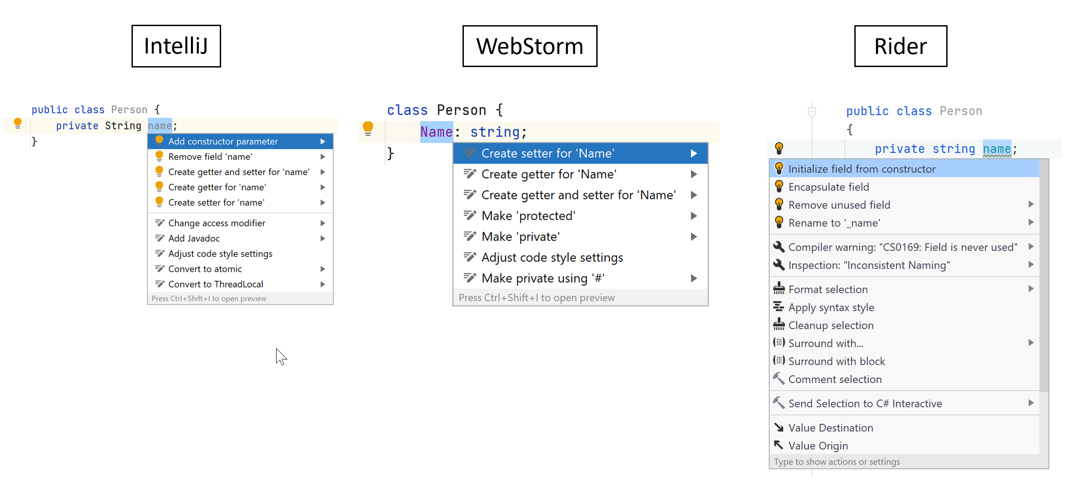
Variability in a feature

Slide 19
Variability expressed in a product
TypeScript code | WebStorm
class Person { get Name(): string { return this._Name; } set Name(value: string) { this._Name = value; } private _Name: string; }
Java code | IntelliJ
public class Person { private String name; public String getName() { return name; } public void setName(String name) { this.name = name; } }
C# code | Rider
public class Person { private string name; public string Name { get => name; set => name = value; } }

Slide 20
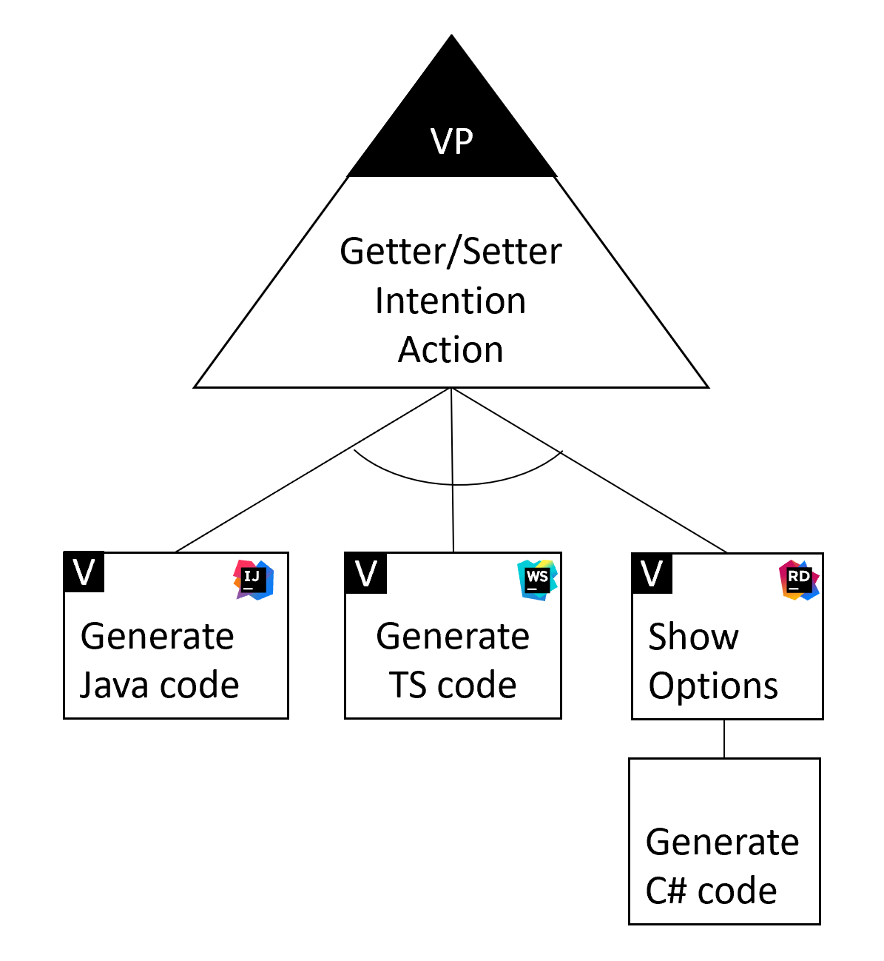
Example model

Slide 21
Greenfield Product Lines
Domain Engineering phase
Requirements
Design commonalities [the product line]
Design variances [product individuation]
Application Engineering phase
Writing the code!
Use technical requirements for reuse/platform

Slide 22
Programming Product Lines Techniques
Extension Points
Inheritance
Dependency Injection
Aspects
Configuration

Slide 23
SPLE at JetBrains
IntelliJ Platform
Base Platform
PSI
Project Model
Features
Plugins
https://plugins.jetbrains.com/docs/intellij/intellij-platform.html

Slide 24
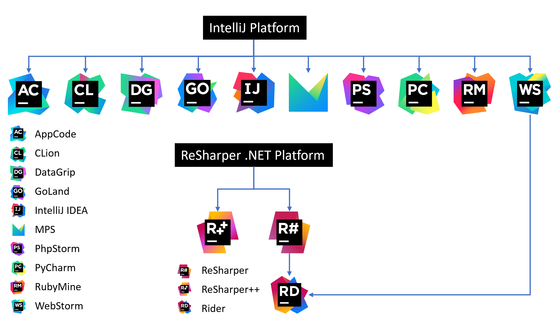
https://github.com/JetBrains/intellij-platform-plugin-template

Slide 25
JetBrains Products History
Circa 2008 | IntelliJ Platform
Platform code
PSI
Project Model
Started the programming restructuring
RubyMine was 1st
Platform still contained IntelliJ
Restructured again for version 2020.3

Slide 26
Migration to SPLE
Much more difficult than greenfield
Use traditional approaches: domain and application engineering practices
Decide which features are the platform and commonalities
Decide which are the variabilities
Restructure and refactor to split code base
This is a project in and of itself
Will take time and energy away from new features
Can introduce new bugs or reversion bugs

Slide 27
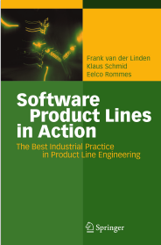
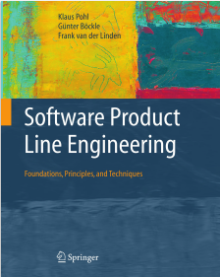
Resources
Software Product Lines in Action
https://www.amazon.com/Software-Product-Lines-Action-Engineering/dp/3540714367
Software Product Lines Engineering
Foundations, Principles, and Techniques
https://www.amazon.com/dp/B000U5HUL2/ref=dp-kindle-redirect?_encoding=UTF8&btkr=1

Slide 28
Thank you!
Rachel Appel
http://rachelappel.com
https://twitter.com/rachelappel
rachel.appel@jetbrains.com

